Slide 1

Introduction to Linux Day 1 of 10
Prepared by:
Gaurav Pokhrel
Rohan Raj Poudel
Jan, 2024
Gaurav P. | Rohan Raj P.

Slide 2
Agenda
Overview of Linux
Key Concepts
Advantages of Linux
Selection criteria for different use cases
Installation
Jan, 2024
Gaurav P. | Rohan Raj P.

Slide 3
1.1 Overview of Linux
1.1.1 Definition: Linux Kernel is an open-source software that serves as the foundation for various operating systems. Kernel is the first program to load after the bootloader. It acts as an intermediary between the hardware and the software.
Jan, 2024
Gaurav P. | Rohan Raj P.

Slide 4
1.1 Overview of Linux
1.1.2 Origin: The development of Linux was initiated by Linus Torvalds in 1991 while he was a student at the University of Helsinki in Finland. The name "Linux" is a combination of Linus's first name and the word "Unix," reflecting the system's Unix-like nature.
Jan, 2024
Gaurav P. | Rohan Raj P.

Slide 5


1.1 Overview of Linux
1.1.3 Application: Linux is used on a wide range of devices, from servers and supercomputers to embedded systems and personal computers.
According to the TOP500 organization, Linux is the preferred operating system for supercomputers, with all 500 of the world's fastest supercomputers running on linux
The Linux kernel serves as the foundation for Android.
Jan, 2024
Gaurav P. | Rohan Raj P.

Slide 6
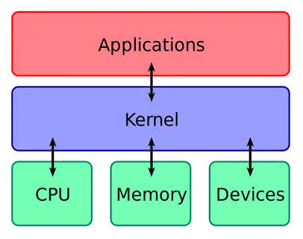
1.2 Key Concepts
1.2.1 Kernel: A kernel is the core component of an operating system that manages system resources and serves as an intermediary between the computer's hardware and software. It is responsible for tasks such as process management, memory management, device drivers, and system calls.
Jan, 2024
Gaurav P. | Rohan Raj P.

Slide 7
1.2 Key Concepts
1.2.1 kernel:
Key Functions of Kernel
Process Management: The kernel oversees the creation, scheduling, and termination of processes. It allocates resources, such as CPU time and memory, to different processes running on the system.
Memory Management: The kernel manages the computer's memory, allocating space for processes and ensuring that they do not interfere with each other. This involves virtual memory management and paging.
Device Drivers: The kernel contains device drivers, which are specialized programs that allow the operating system to communicate with hardware devices, such as printers, disk drives, and network interfaces.
Jan, 2024
Gaurav P. | Rohan Raj P.

Slide 8
1.2 Key Concepts
1.2.1 key functions of a kernel:
System Calls: The kernel provides a set of system calls, which are interfaces that allow user-level processes to request services from the operating system, such as file operations or network communication.
Interrupt Handling: The kernel handles hardware and software interrupts. Hardware interrupts are signals sent by external devices to request attention from the CPU, while software interrupts are triggered by software events.
Security: The kernel enforces security policies, controls access to system resources, and ensures the integrity of the operating system.
Jan, 2024
Gaurav P. | Rohan Raj P.

Slide 9





1.2 Key Concepts
1.2.2 Distributions: Linux distributions, also known as Linux distros, are complete operating systems based on the Linux kernel and a collection of software applications and utilities. While the Linux kernel is the core component, a distribution includes additional components such as system libraries, software packages, package management tools, desktop environments, etc.
Linux distro based on Debian
Linux distro based on RHEL
Linux distro based on Ubuntu
Jan, 2024
Gaurav P. | Rohan Raj P.

Slide 10
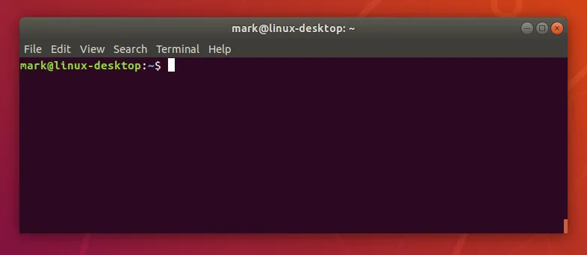
1.2 Key Concepts
1.2.2 Terminal : A terminal is a program that provides a text-based interface and allows users to interact with the shell. It allows users to type commands and receive text-based feedback.
Terminals can be graphical or command-line based.
Graphical Terminal: In a graphical environment, a terminal emulator provides a window where users can enter commands. Example GNOME Terminal
Command-Line Interface (CLI): On systems without a graphical interface or for users who prefer the command line, a text-based terminal is available. This is often referred to as a virtual console. You can switch between virtual consoles using keyboard shortcuts (e.g., Ctrl+Alt+F6 in Ubuntu).
Jan, 2024
Gaurav P. | Rohan Raj P.

Slide 11
1.2 Key Concepts
1.2.3 Shell : A shell is a program that provides an interface to launch commands or another program inside a terminal. A shell is a user interface for accessing the services of an operating system. Example: bash, power shell
The shell acts as an intermediary between the user and the operating system. With the help of commands that the shell interprets and executes, users can communicate with the system. The shell transfers user requests to the kernel so that it can process them, acting as an a link between the two. It executes the necessary actions, and then displays the results.
Jan, 2024
Gaurav P. | Rohan Raj P.

Slide 12
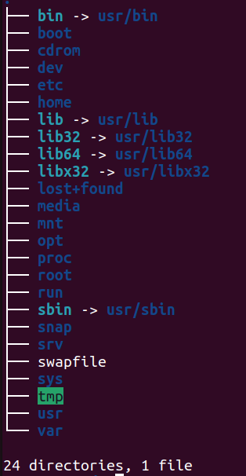
1.2 Key Concepts
1.2.4 File System: The file system in Linux is represented as a hierarchical tree structure with a root directory ("/") at the top. Directories (folders) and files are organized under this root directory.
Jan, 2024
Gaurav P. | Rohan Raj P.

Slide 13
1.2 Key Concepts
1.2.5 Path : A path is a unique identifier for a file or directory in the file system. There are two types of paths: Absolute and relative.
Absolute Path: An absolute path specifies the location of a file or directory from the root directory. It starts with the root directory ("/") and lists all the directories leading to the target file or directory. For example: /home/user/Documents/file.txt
Relative Path: A relative path specifies the location of a file or directory relative to the current working directory.
"." : (Optional)Represents the current directory. (example: ./Pictures/photo.jpg)
".." : Represents the parent directory. (example: ../Pictures/photo.jpg)
Jan, 2024
Gaurav P. | Rohan Raj P.

Slide 14
1.3 Advantages of Linux
Security: Linux has a strong security model with built-in features such as user permissions, access controls, and regular security updates.
Flexibility: Linux is highly customizable. Users can choose from a variety of desktop environments, window managers, and software packages to create a personalized computing environment. –(people creating macOS like interface in non Apple Laptops)
Cost-Efficiency: Linux is free to use, reducing software licensing costs. Many open-source applications and tools are available for free, contributing to a cost-effective computing environment.
Community Support: The Linux community is vast and active. Users can access forums, documentation, and online resources for support and troubleshooting.
Jan, 2024
Gaurav P. | Rohan Raj P.

Slide 15
1.4 Selection criteria
General Desktop Use: Ubuntu (with variants like Ubuntu Desktop, Kubuntu, Xubuntu), Linux Mint, Fedora Workstation.
Server Environment: CentOS, Ubuntu Server, Debian.
Security and Penetration Testing: Kali Linux, Parrot Security OS.
Internet of Things (IoT) Devices: Raspbian (for Raspberry Pi), Yocto Project.
Jan, 2024
Gaurav P. | Rohan Raj P.

Slide 16
1.5 Installation
Disable Secure Boot
Enable Virtualization
Install Oracle VM VirtualBox
Install Ubuntu in your Virtual environment
Jan, 2024
Gaurav P. | Rohan Raj P.

